Slide 1
Human Computer Interaction
The Interaction
Chapter 3A
Imran Siddiqi
imran.siddiqi@mcs.edu.pk

Slide 2
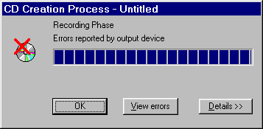

Today’s Interface Hall of Shame
Problem?
Dialogs are far too similar
Heavy red icon
Error in CD creation
CD creating successful
Introduction

Slide 3

Today’s Interface Hall of Shame
In/Out Whiteboard application
Is the individual 'in' or 'out'?
Given the bright green color and the raised appearance of the ‘In’ button, one gets the impression that the individual is 'in'
Actually, the individual is ‘out’
Introduction

Slide 4
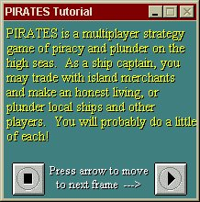

Today’s Interface Hall of Shame
Improper use of colour
Color combination particularly hurtful on the eyes
Use of 3D Font – even harder to read
Introduction

Slide 5
Contents
Introduction
Models of Interaction
Ergonomics
Interaction Styles
Interactivity
Experience, Engagement & Fun
The Interaction

Slide 6
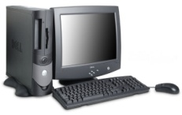
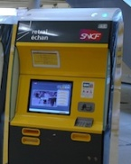

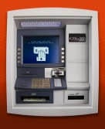
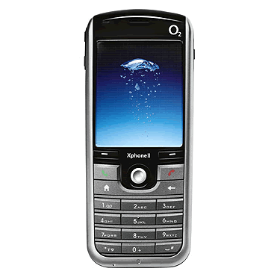
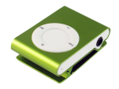
Introduction
What is Interaction
Communication
Machine is capable of doing the job
Humans need to get the job done from the system
User
System
User must communicate his requirements to the system
The Interaction

Slide 7
Contents
Introduction
Models of Interaction
Ergonomics
Interaction Styles
Interactivity
Experience, Engagement & Fun
The Interaction

Slide 8
Models of Interaction
Communication: Complex Human – Complex Systems
Models of Interaction
  Help Understand what is going on in the Interaction
  Identify the likely root of difficulties
Two Models
  Norman’s Model (The execution-evaluation cycle)
  Abowd and Beale framework
The Interaction

Slide 9
Some Terms of Interaction
Domain
  The area of work under study
  Graphic design➔ Graphic shapes, drawing surface, drawing utensils
Goal
  What you want to achieve
  e.g. create a solid red triangle
Domain
Concepts of Domain
The Interaction

Slide 10
Some Terms of Interaction
Task
  How you go about doing it – Ultimately in terms of operations or actions
  e.g. … select fill tool, click over triangle
Task Analysis
  Identification of problem space for user of an interactive system in terms of the domain, goals and tasks
The Interaction

Slide 11
Some Terms of Interaction
Task Language
  User’s language: Describes attributes of domain relevant to the User state
Core Language
  System’s Language: Describes attributes of domain relevant to the System state
The Interaction

Slide 12
Norman’s Model of Interaction
Based on Execution – Evaluation Cycle
Two major stages: Execution & Evaluation
Execution
  Establishing the goal
  Forming the intention
  Specifying the action sequence
  Executing the action
Evaluation
  Perceiving the system state
  Interpreting the system state
  Evaluating the system state with respect to the goals and intentions
The Interaction

Slide 13
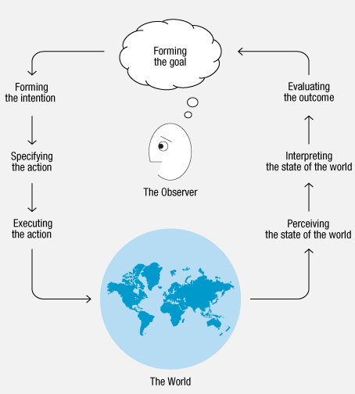
Norman’s Model of Interaction
The Interaction

Slide 14
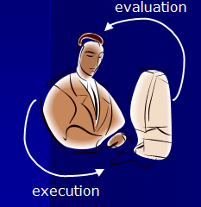

Execution – Evaluation Cycle
goal
execution
evaluation
system
Example – Switching on the Light
  Evening falls while reading
The Interaction

Slide 15
Execution – Evaluation Cycle
  Establishing the goal
  Forming the intention
  Specifying the action sequence
  Executing the action
  Perceiving the system state
  Interpreting the system state
  Evaluating the system state
goal
execution
evaluation
system
You decide you need more light. Goal : Get more light
Intention: Switch on the lamp
Specify the Action Sequence to reach over an press the lamp switch
Action executed – Perceive the results: Light is on or not
Interpret – e.g. No light: Bulb has blown, Lamp not plugged in -> New Intentions
Light comes out – Evaluate the new state according to your goal
If the light is enough – Cycle Completes
If NOT, formulate a new intention of switching on the ceiling light for example
The Interaction

Slide 16
Using Norman’s Model
Some Systems are harder to use than others
Gulf of Execution – Difference b/w
  User’s formulation of actions & Actions allowed by the system
  I can’t accomplish my goal using the Interface
  AIM: Reduce this gulf
Gulf of Evaluation – Difference b/w
  Presentation of the system state & User Expectation
  I can’t figure out whether I accomplished my goal or not
  More effort required to interpret presentation: Less effective Interaction
The Interaction

Slide 17
Human Error – Slips & Mistakes
Slip
  Understand system and goal
  Correct formulation of action
  Incorrect action
Mistake
  May not even have right goal!
Example
  Slip: Mistype, accidental mouse press
  Mistake: Magnifying glass icon – Find/Zoom
The Interaction

Slide 18
Human Error – Slips & Mistakes
Fixing Errors
Slips
  Better interface design
  E.g. Putting more space b/w buttons
Mistakes
  Better understanding of the system
  Improved training, radical redesigning
The Interaction

Slide 19
Abowd & Beale Framework
Interaction framework – Four parts
  User
  Input
  System
  Output
Each part has its own unique language
Interaction = Translation b/w languages
Input + Output = Interface
Interface sits b/w User and System
O
output
S
core
U
task
I
input
The Interaction

Slide 20
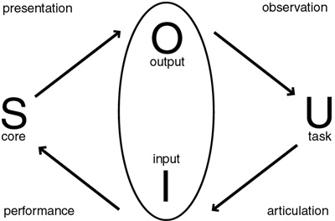
Abowd & Beale Framework
Interactive Cycle
  User begins with formulation of a Goal/Task
  Task articulated within the input language
  Input language is translated to core language as operations to be performed
  System transforms itself
Performance
Articulation
System is in a new State
The Interaction

Slide 21
Abowd & Beale Framework
Interactive Cycle (Contd…)
  System attribute values rendered to Output
  User observes the output and asses the result of interaction w.r.t the Goal
Presentation
Observation
Performance
Articulation
Problems in interaction = Problems in translation
The Interaction

Slide 22
Abowd & Beale Framework
Example: Video Recording using a remote control
Ineffective Interaction: User not sure VCR is set to record properly
Articulation: User pressed the keys on the remote in the wrong order
Performance: VCR may record any channel but remote control lacks the channel selection
Presentation: VCR display does not indicate the setting of program
Observation: User does not interpret the feedback properly
The Interaction

Slide 23
Contents
Introduction
Models of Interaction
Ergonomics
Interaction Styles
Interactivity
Experience, Engagement & Fun
The Interaction

Slide 24

Ergonomics
Physical Aspects of Interaction
The Interaction

Slide 25
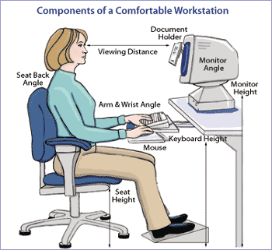
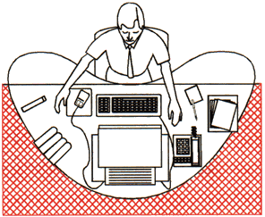
Ergonomics
Ergonomics is the science of designing the job equipment, and workplace to fit the worker
Ergonomics involves arranging the environment to ‘fit’ the person in it
Ergonomic Design/Products
  Easy to use and comfortable
  Reduce fatigue, strain
  Enhance productivity
The Interaction

Slide 26
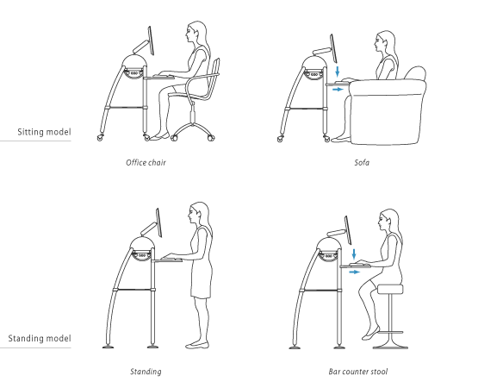
Ergonomics Examples
Arrangement of Controls & Displays
  Grouped according to: Function, Sequence, Frequency
Surrounding Environment
  Design of work Environment
  Where will the system be used?
  Who will use it?
  For how long will it be used?
  Seated users: Comfort, Back support etc.
The Interaction

Slide 27
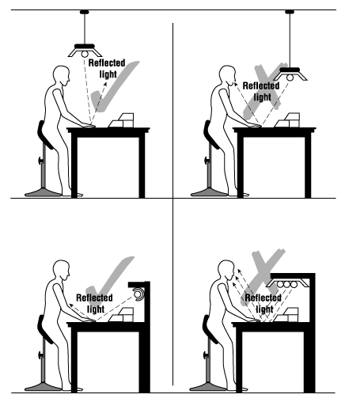
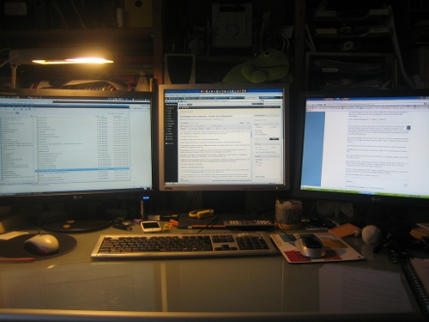
Ergonomics Examples
Health Issues
  Lighting, Noise, Temperature, Time Spent etc.
Lighting Ergonomics
The Interaction

Slide 28
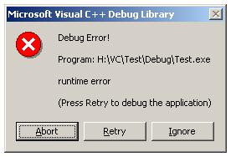
Ergonomics Examples
Use of Colour
  An indicator – Not the only Cue
  Color use – Coherent with common conventions
    Red for Warning etc.
The Interaction

Slide 29

References
Chapter 3 - Human Computer Interaction by Dix et al.
User Interface Hall of Fame/Shame
The Interaction

